Slide 1
Principal-agent solutions I

Slide 2
Principal-agent solutions
Conditions for principal-agent problems:
  (1) Objectives of principals and agents differ
  (2) Actions or information possessed by agent are hard to observe

Slide 3
Principal-agent solutions
Solution 1: Bureaucracy
  Monitor employees and gather information to reduce gap
  Example: corporate boards of directors monitor decisions of firm’s CEO and gather financial statements, reports, etc.
  Problems: imperfect, costly, and may induce more P-A relationships

Slide 4
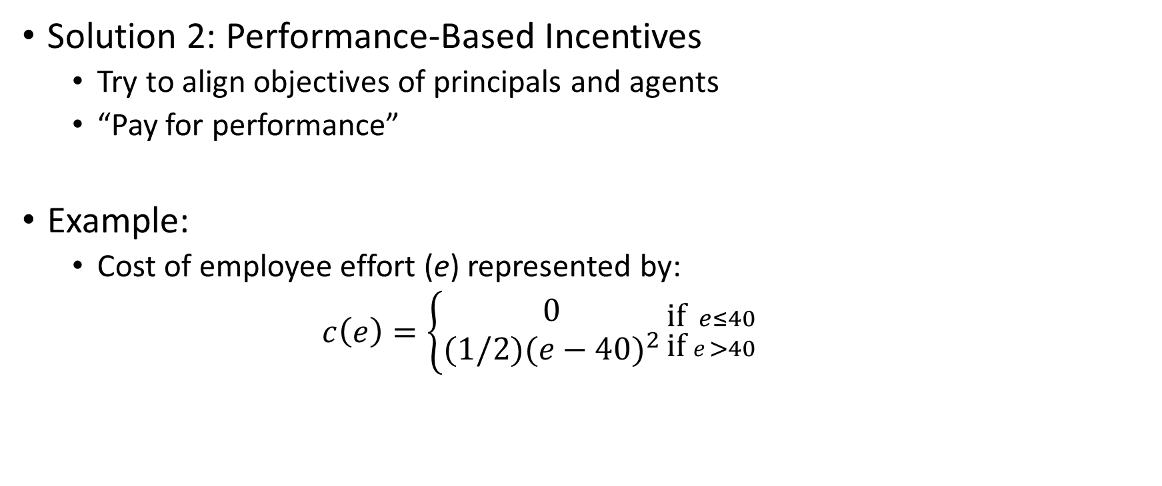
Principal-agent solutions
Solution 2: Performance-Based Incentives
  Try to align objectives of principals and agents
  “Pay for performance”
Example:
  Cost of employee effort (e) represented by:
  $c\left(e\right)=\left\{\begin{aligned}0 \\ (1/2{)(e−40)}^{2}\end{aligned}{\text{if} e≤40 \atop \text{if} e>40}\right.$

Slide 5
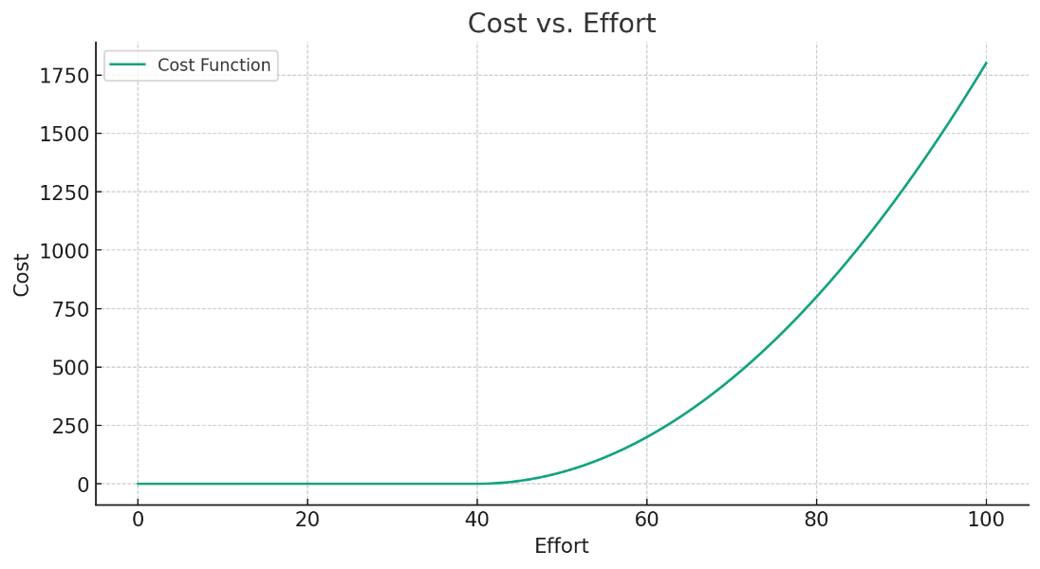
Principal-agent solutions

Slide 6
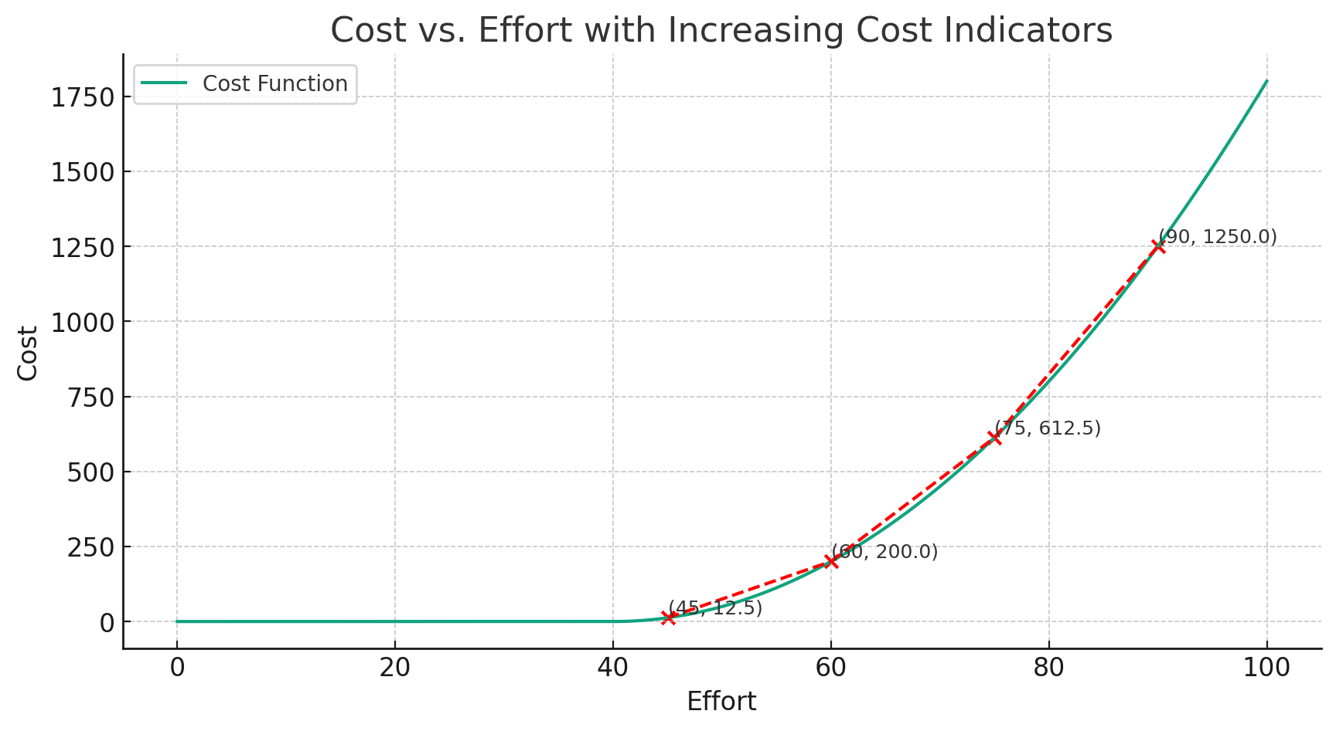
Principal-agent solutions

Slide 7

Principal-agent solutions
  Cost of employee effort (e) represented by:
  $c\left(e\right)=\left\{\begin{aligned}0 \\ (1/2{)(e−40)}^{2}\end{aligned}{\text{if} e≤40 \atop \text{if} e>40}\right.$
  Sales represented by:
  $$sales=\text{€}100∗e$$

Slide 8

Principal-agent solutions
  Baseline case:
    $wage = €1,000$
    $e = 40$
    $sales = €4,000$
    Profit of €3,000
  However:
    $∆$1e → €100 firm sales
    $∆$1e → ($c\left(41\right)−c\left(40\right)$) €0.50 worker cost
    Potential €99.50 net surplus

Slide 9
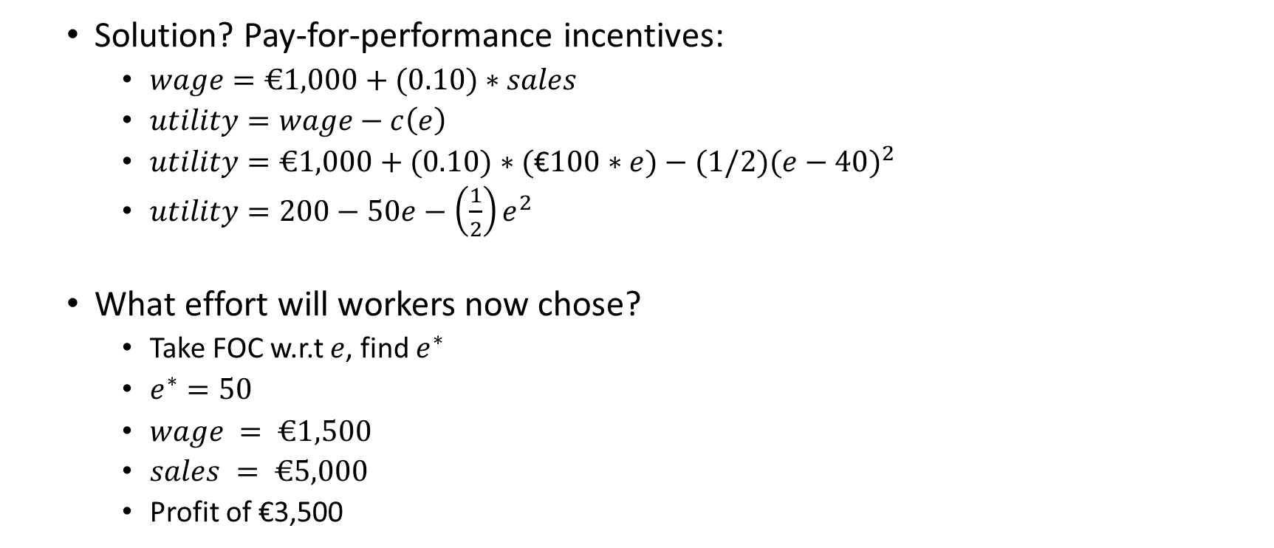
Principal-agent solutions
  Solution? Pay-for-performance incentives:
    $wage=€1,000+(0.10)∗sales$
    $utility=wage−c\left(e\right)$
    $utility=€1,000+(0.10)∗(\text{€}100∗e)−(1/2{)(e−40)}^{2}$
    $utility=200−50e−\left(\frac{1}{2}\right)e^{2}$
  What effort will workers now chose?
    Take FOC w.r.t $e$, find $e^{∗}$
    $e^{∗}=50$
    $wage = €1,500$
    $sales = €5,000$
    Profit of €3,500

Slide 10
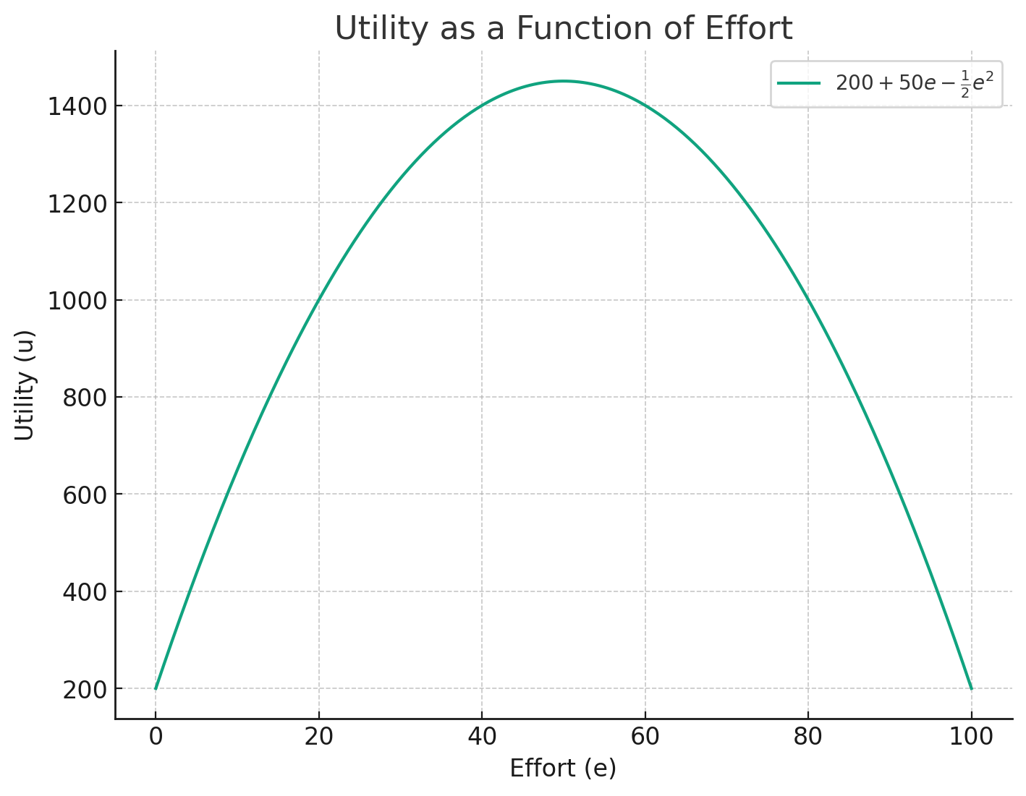
Principal-agent solutions

Slide 11
Principal-agent solutions
Wrap-up
  Bureaucracy
  Pay-for-performance
  Small model

